Slide 1
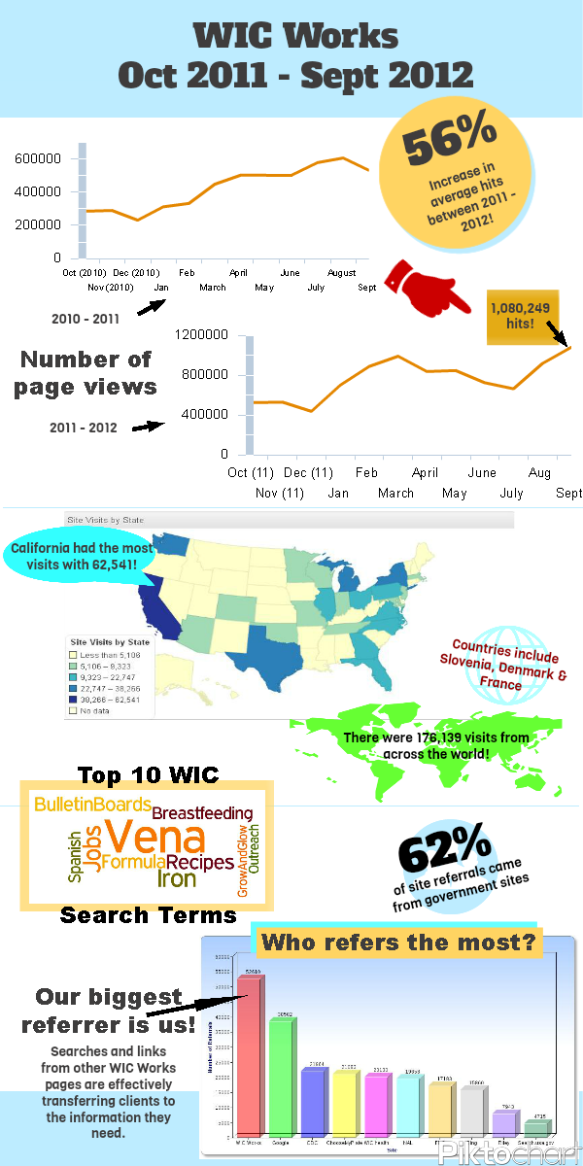
Infographics
Jennifer Vargas

Slide 2

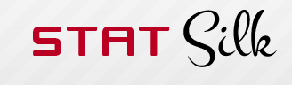

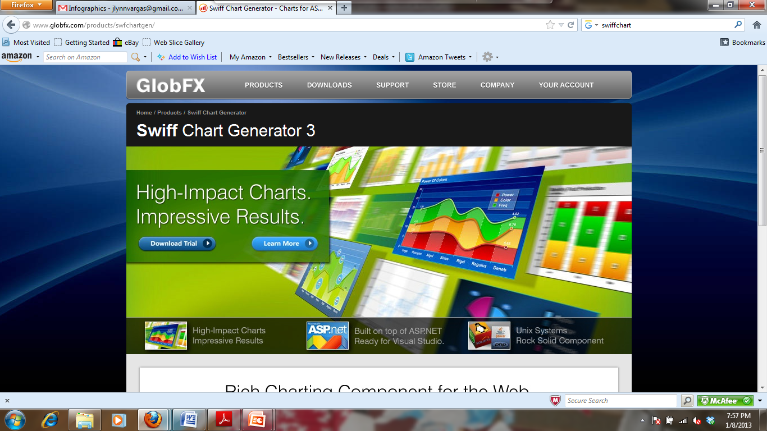

Technology is our Future

Slide 3

What are infographics?
Presenting statistics graphically.
Looking for new tools to present statistics in a more interesting way.
  Website hits
  Users by state
  Common search terms
Word Cloud

Slide 4
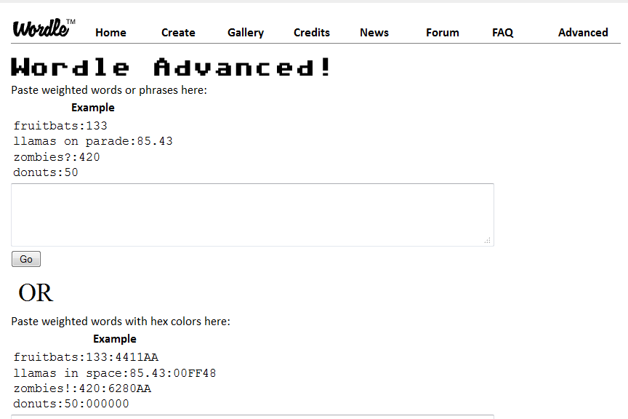
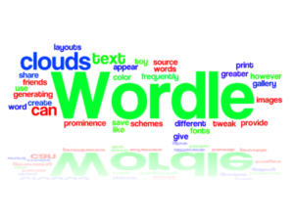
Wordle Word Clouds

Slide 5
Swiff Chart Generator

Slide 6
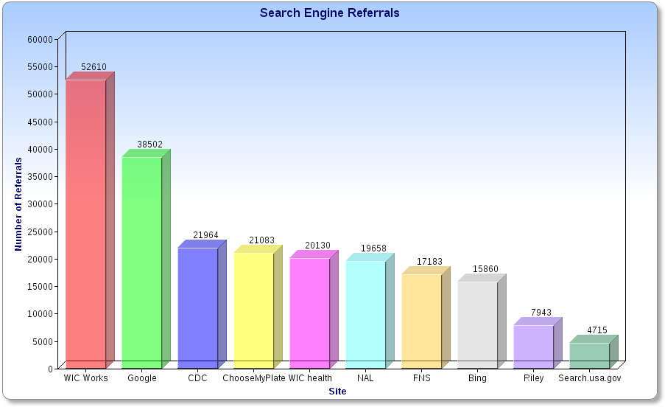
Top Ten Site Referrals
WIC Works

Slide 7
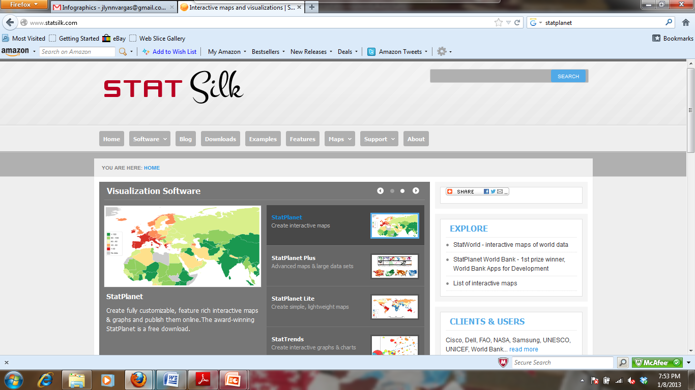
StatPlanet

Slide 8
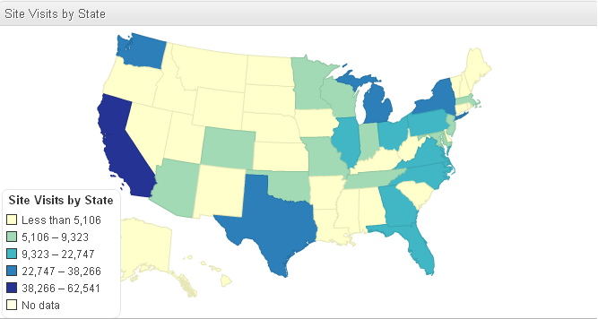
Site Visits by State (per year)

Slide 9
The finished product!

Slide 10
Why do we need them?
Reimbursements
Presenting results to Doctors, etc.
Public Interest

Slide 11

Jennifer Vargas

Slide 12
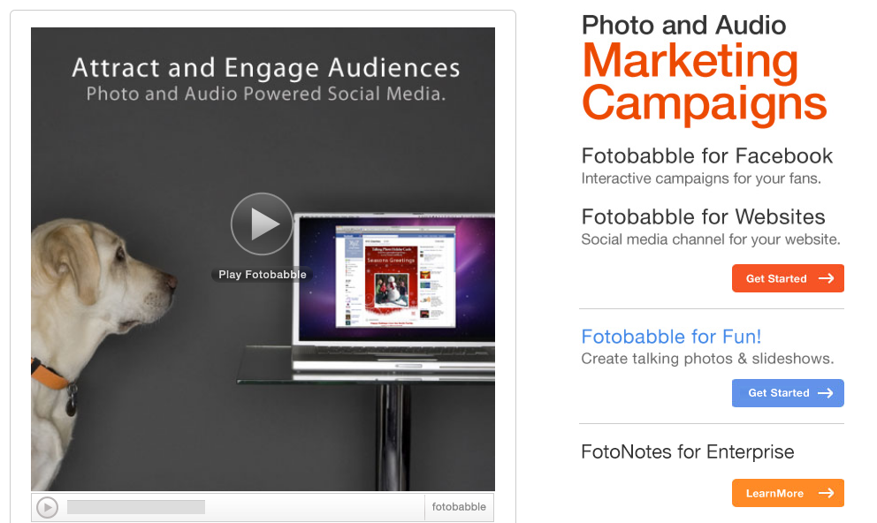
What is Fotobabble?
Talking photos and slideshows

Slide 13
What can I use it for?
Audio “scrapbooking”
Blog
Shopping list
E-Cards
Photo supported podcasts
Product review
Enhance your Facebook page
Review songs, movies, etc.
Travel postcards
Talking recipes

Slide 14
Why do I need it?
More than just a podcast
Verbal step-by-step recipes
Talking blog
More interesting for some; critical for others.
  Low-literacy population

Slide 15
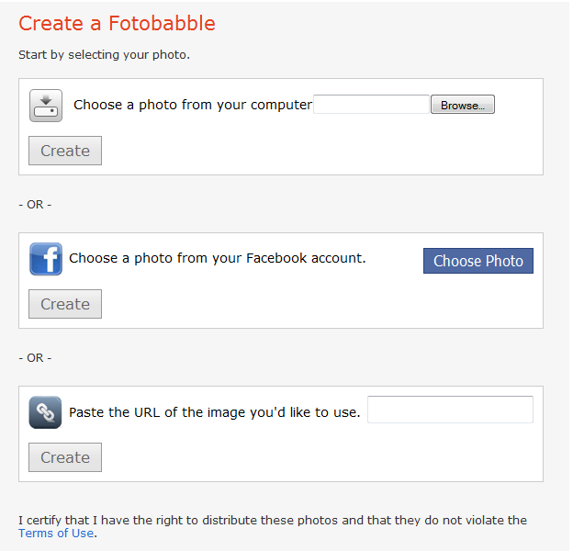
Method 1
Method 2

Slide 16
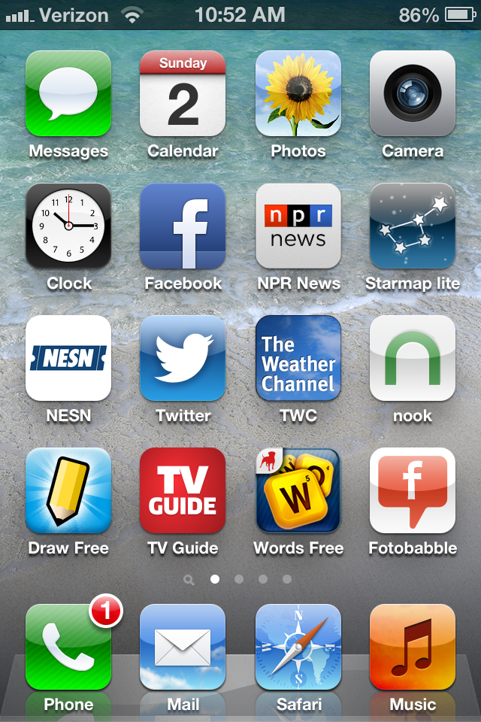
Fotobabble for iPhone

Slide 17
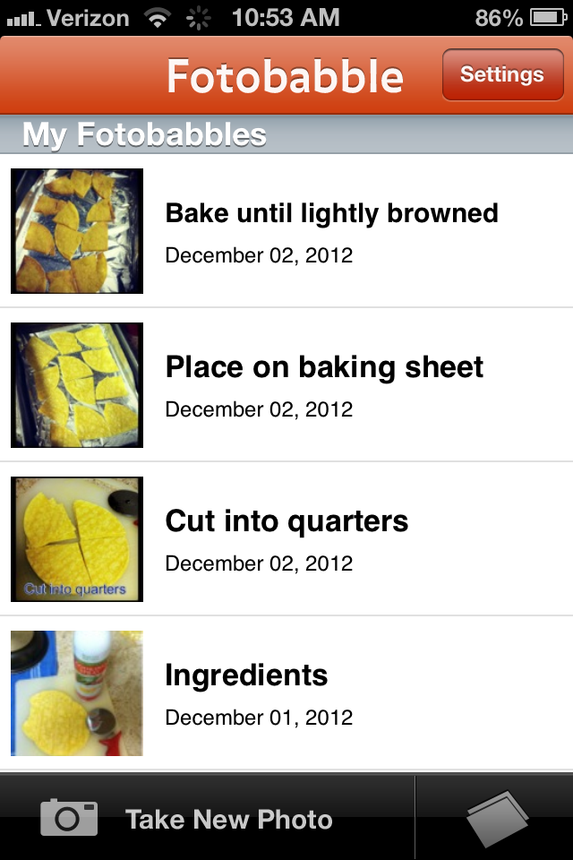
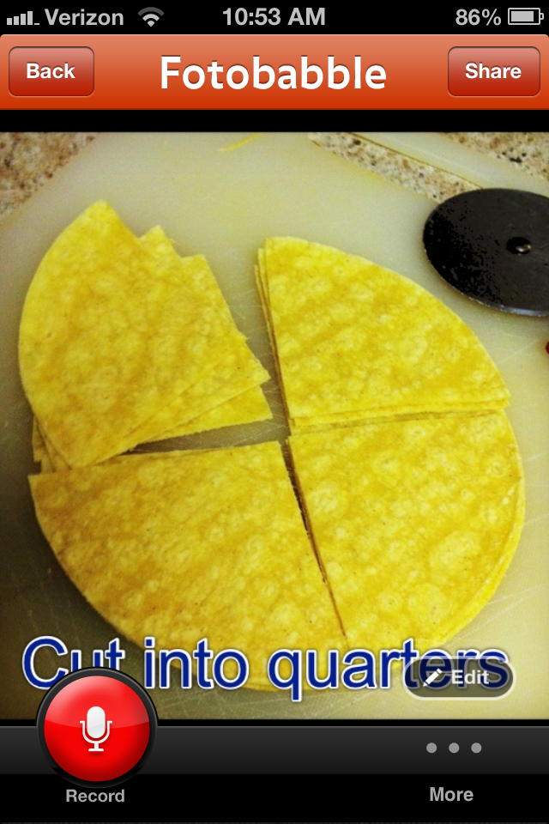

Slide 18
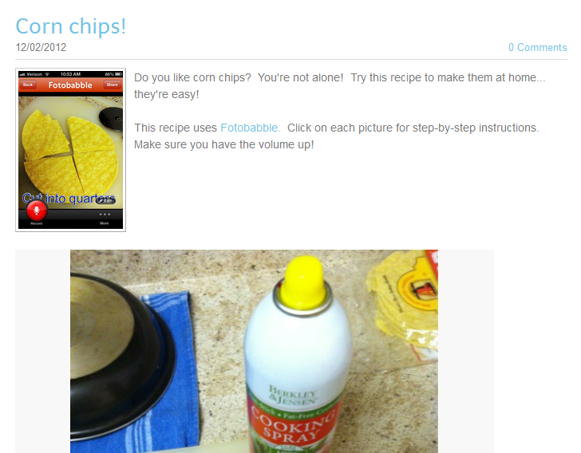
Embed in your blog

