Slide 1

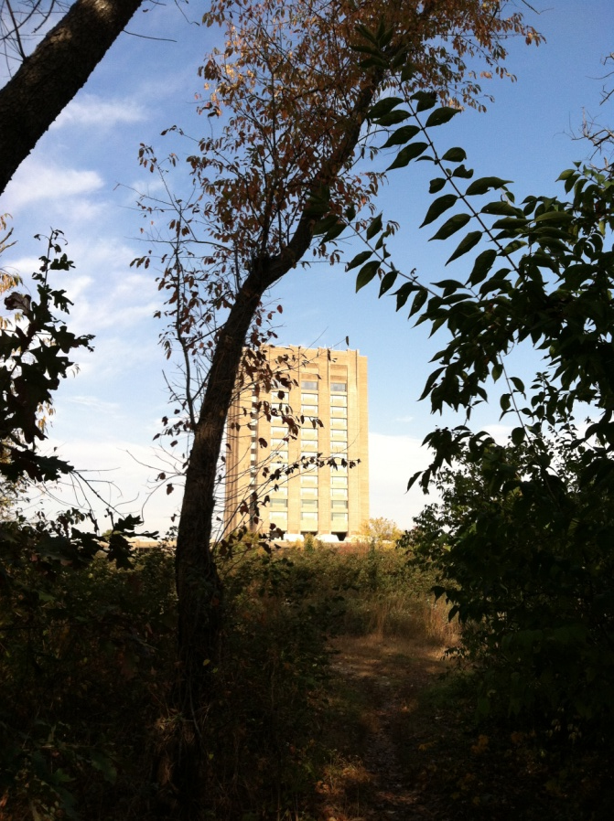
Jennifer Vargas
October 23 – November 30, 2012
National Agriculture Library

Slide 2


Slide 3




Technology is our Future

Slide 4
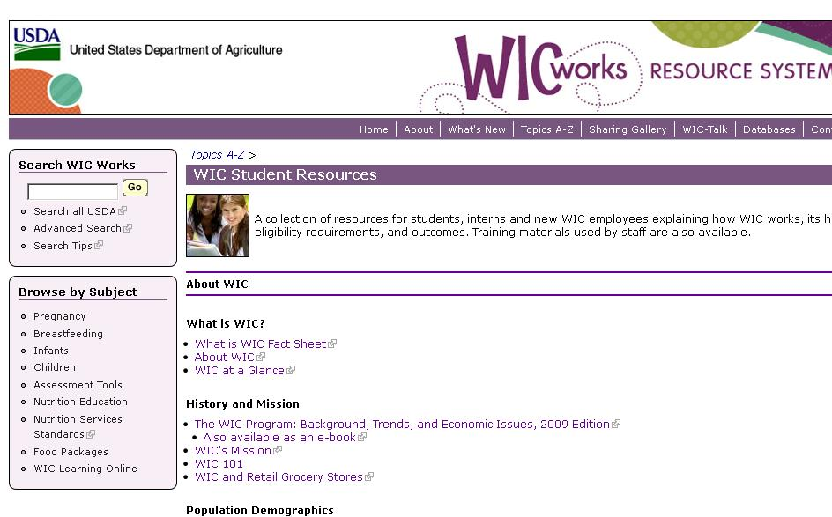
Student Resources
Total views since creation: 327

Slide 5
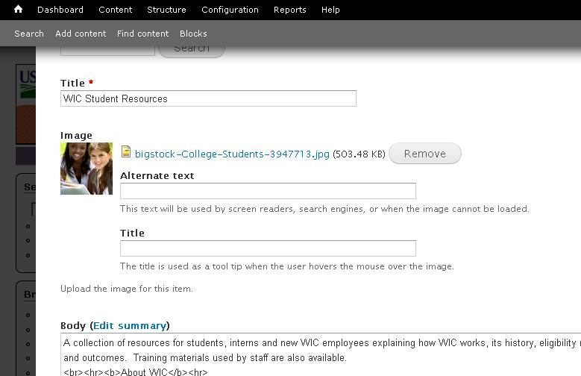
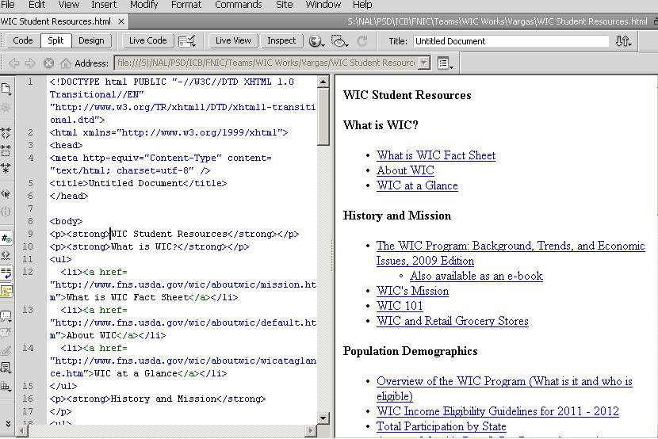
How It’s Made

Slide 6
Database Management
Educational Resources
Topics A-Z
Breastfeeding Peer
Counseling Resources

Slide 7
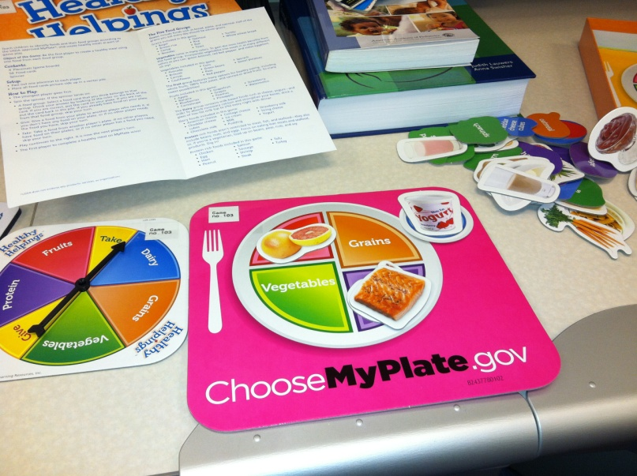

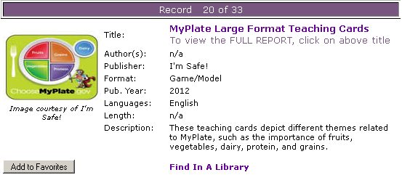
Educational Resources
Review materials
Updating database

Slide 8
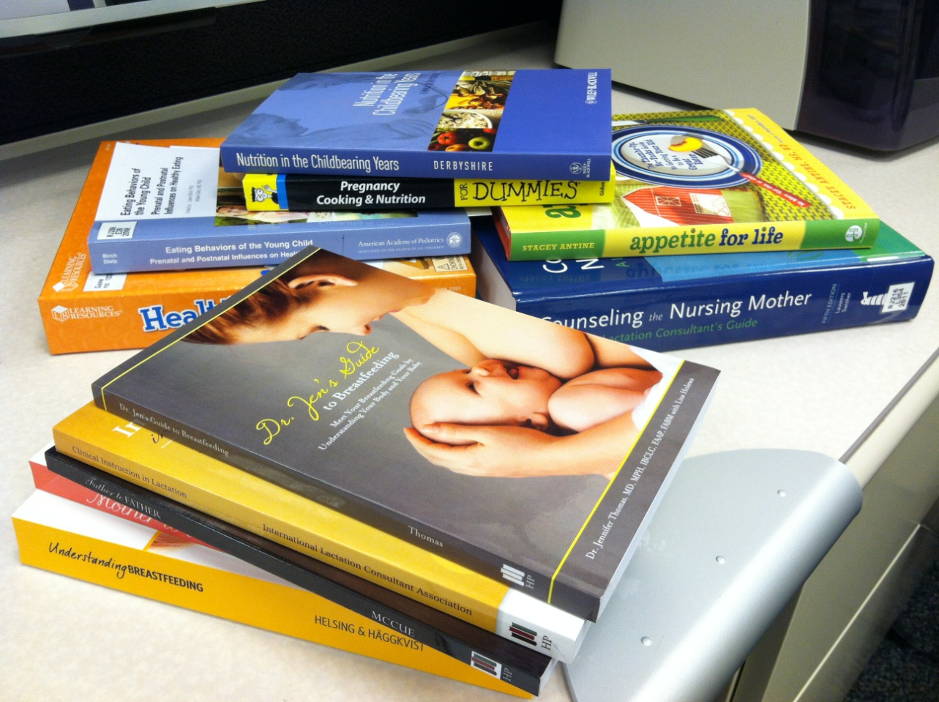
Educational Resources
Books
DVD’s
CD’s
Games

Slide 9
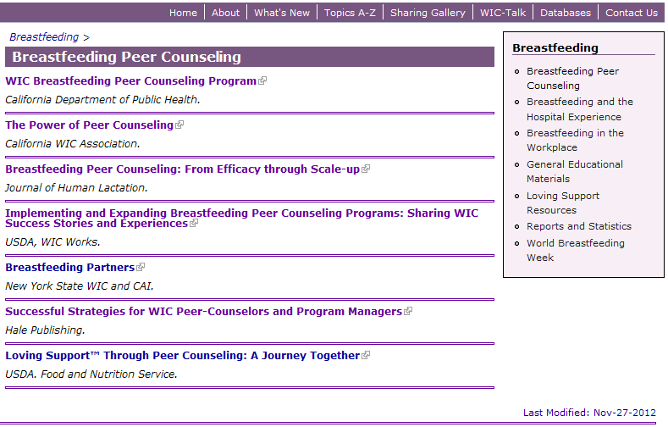
Breastfeeding Peer Counseling

Slide 10

Infographics
Presenting statistics graphically.
Looking for new tools to present statistics in a more interesting way.
  Website hits
  Users by state
  Common search terms

Slide 11
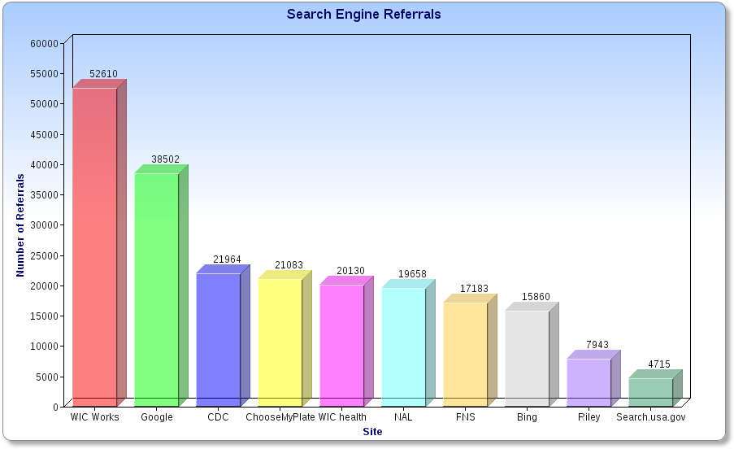
Top Ten Site Referrals

Slide 12
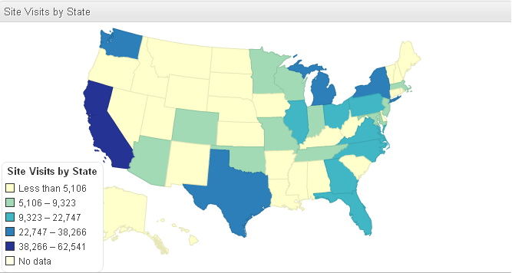
Site Visits by State (per year)

Slide 13
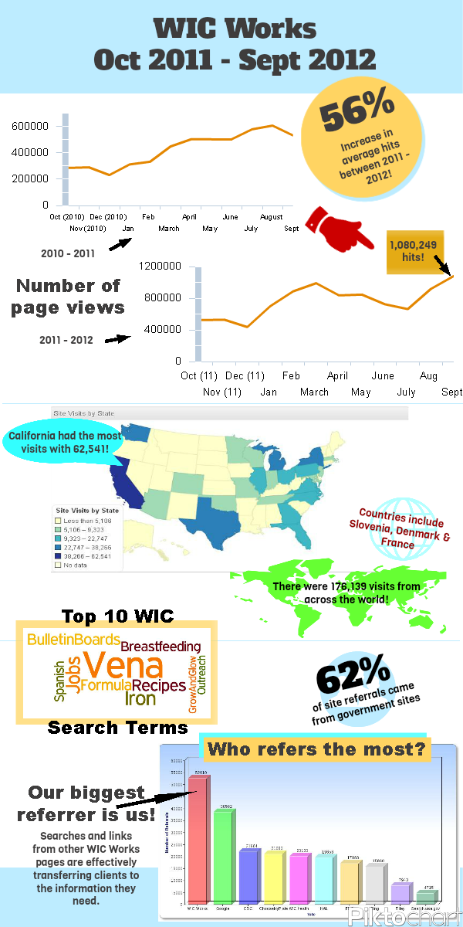
The finished product!

Slide 14

Research!
Student resources
Peer-counseling
Publishers/new review materials
Skillsoft modules
Webinars
Counseling strategies

