Slide 1
Jenn Vargas

Slide 2
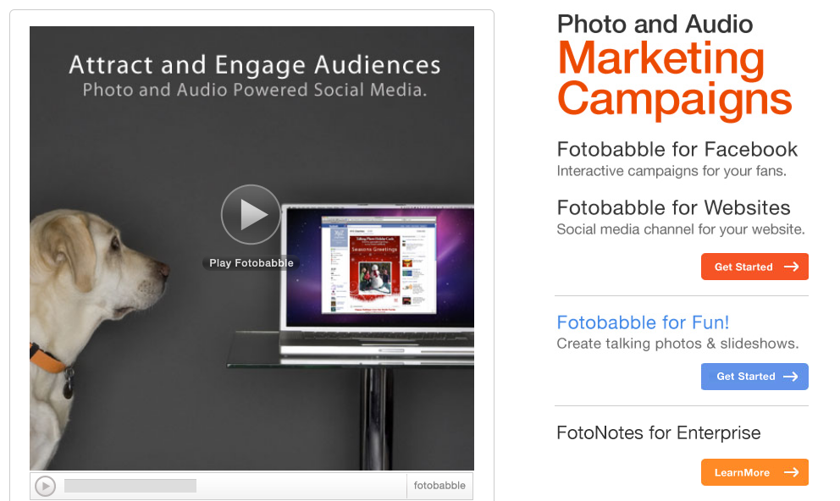
What is Fotobabble?
Talking photos and slideshows

Slide 3
What can I use it for?
Audio “scrapbooking”
Blog
Shopping list
E-Cards
Photo supported podcasts
Product review
Enhance your Facebook page
Review songs, movies, etc.
Travel postcards

Slide 4
Why do I need it?
More than just a podcast
Verbal step-by-step recipes
Talking blog
More interesting for some; critical for others.
Low-literacy population

Slide 5
Example:

Slide 6
How do I use it?
What you’ll need:
A picture
A microphone/webcam

Slide 7
Method 1
Method 2

Slide 8
Method 1

Slide 9
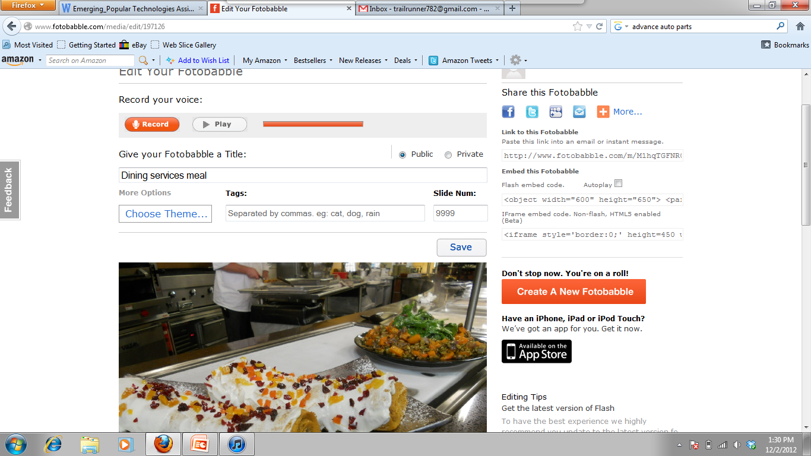

Slide 10
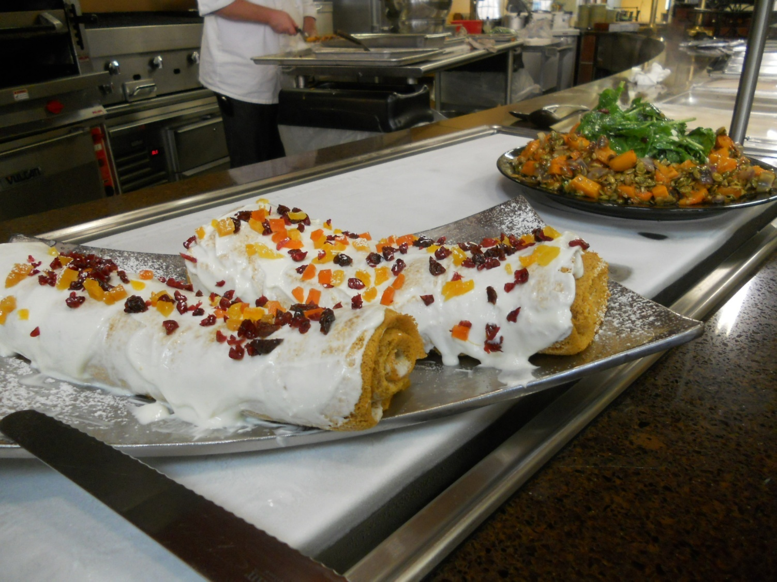
The Finished Product!

Slide 11
Method 2

Slide 12
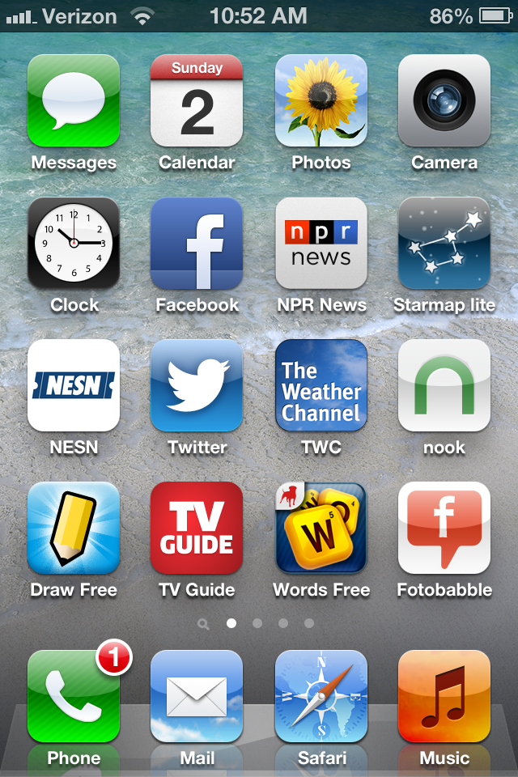
Fotobabble for iPhone

Slide 13
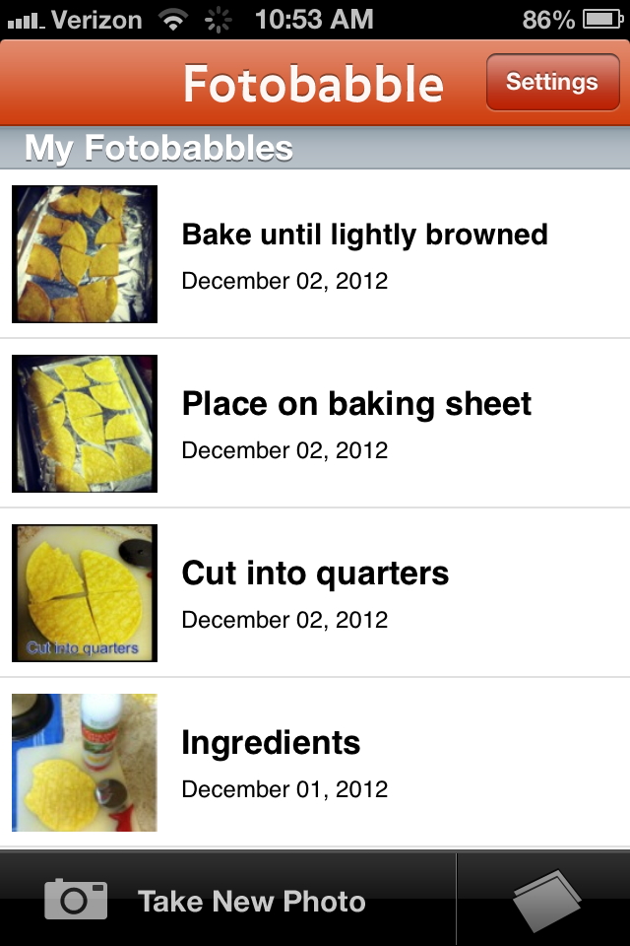
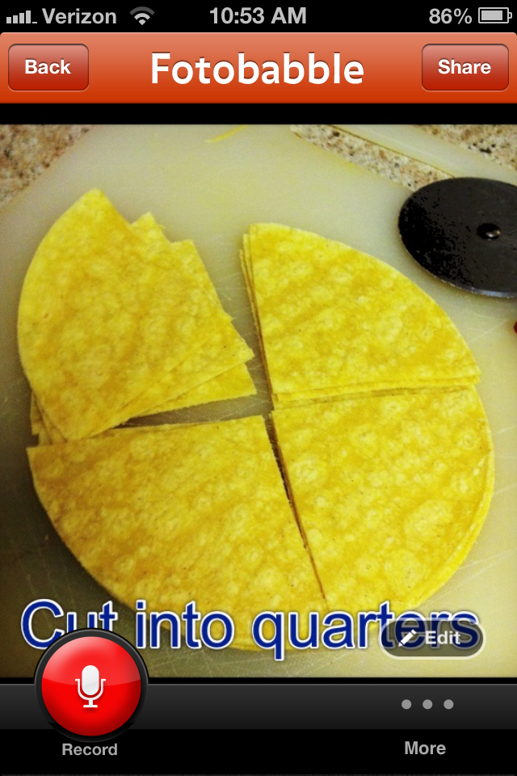

Slide 14
Embed in Weebly

Slide 15
